Slide 1
SMART ATTENDANCE SYSTEM
GUIDE: MISS.SATHYA K
BY,
RITHIKA.J – 717821I241
KRISHNAVENI.N - 717821I225
NANTHIKA.S – 717821I233
MANJUBHASHINI.R – 717821I229
CHAILA SHREE.G – 717821I207

Slide 2
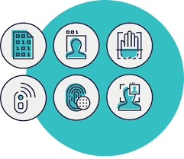
PROBLEM STATEMENT
●Traditionally attendance is manually by teachers and they must make sure correct attendance is marked for respective students . This whole process wastes some of the lecture time and part of correct information is missed due to fraudulent and proxy cases.
● This application is built for automating the processing of attendance. It also enhances the speed of performing attendance tasks easily.

Slide 3

ABSTRACT
● The main objective of this project is to calculate the attendance of students in an easier way. We proposed an automated attendance management system that uses a face recognition method to give solutions to the faculty thereby reducing the burden in taking attendance
● An efficient face recognition based attendance system has been developed by improving the efficiency of the system and also for the secured attendance . Those attendance of the students will be recorded in the Excel sheet with date and time
This Photo by Unknown Author is licensed under CC BY-ND

Slide 4
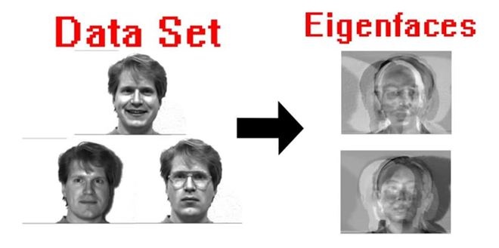
INTRODUCTION
The algorithm used in this system is Eigen Faces . It is a method that is useful for face recognition and detection by determining the variance of faces in a collection of face images and using those variances to encode and decode a face in a machine learning way without the full information reducing computation and face complexity

Slide 5
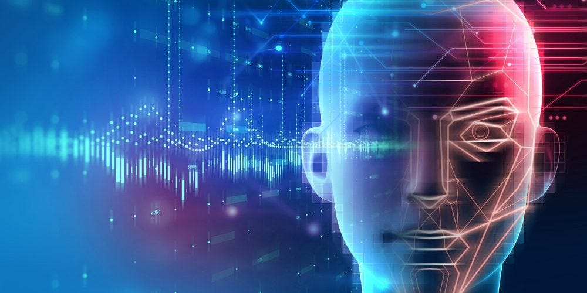
The essence of eigenfaces is an unsupervised dimensionality reduction algorithm called Principal component analysis(PCA) is a linear dimensionality reduction technique that we use to reduce the dimensionality of images into something smaller.

Slide 6
LITERATURE
SURVEY

Slide 7
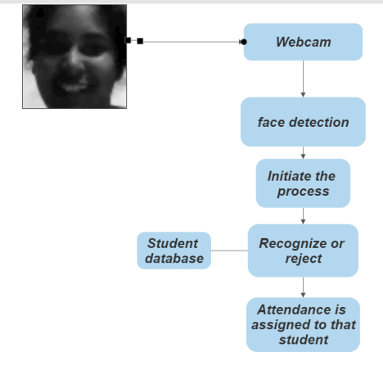
FLOW CHART

Slide 8



ADVANTAGES
CONVENIENT
N0 CONTACT
TIME MANAGEMENT

Slide 9


DISADVANTAGES
IDENTICAL TWINS ATTACK
AFFECTED BY APPEARANCE / ENVIRONMENT

Slide 10
REFERENCE
https://www.researchgate.net/publication/326261079_Face_detection_ System_for_attendance_of_class’_students
Hapani, Smit, et al. "Automated Attendance System Using Image Processing."
https://becominghuman.ai/face-detection-using-opencv-with-haar- cascade-classifiers-941dbb25177
Rathod, Hemantkumar, et al. "Automated attendance system using machine learning approach." 2017 International Conference on Nascent Technologies in Engineering (ICNTE). IEEE, 2017

Slide 11
THANK YOU!!

